Slide 1
Session 4
Array, String, Binary Search

Slide 2
Arrays
Arrays are data structures that allow you to store multiple elements of the same type in a contiguous memory block.
They have a fixed size, which is defined at the time of declaration.
Elements in an array can be accessed using their index, starting from 0.
Declaration of Arrays
Arrays can be declared using square brackets [ ] after the data type.
Example: int[] numbers;
Initialize Arrays
Arrays can be initialized using curly braces {} with comma-separated values.
Example: int[] numbers = {1, 2, 3, 4, 5};
Accessing Array Elements
Array elements can be accessed using their index.
Example: int thirdElement = numbers[2]; // thirdElement will be 3
Array Length and Bounds
The length of an array can be obtained using the length property.
Example: int arrayLength = numbers.length; // arrayLength will be 5
Array bounds represent the valid range of index values for the array.
Common Array Operations
Common operations include traversing, searching, and modifying array elements.

Slide 3
Array Examples
1. Sum of Array Elements
int[] numbers = {1, 2, 3, 4, 5};
int sum = 0;
for (int num : numbers) {
sum += num;
}
System.out.println("Sum: " + sum);
// Output: Sum: 15
2. Finding the Maximum and Minimum Values in an Array
int[] numbers = {10, 5, 25, 3, 15};
int max = numbers[0];
int min = numbers[0];
for (int num : numbers) {
if (num > max) {
max = num;
}
if (num < min) {
min = num;
}
}
System.out.println("Max: " + max + ", Min: " + min);
// Output: Max: 25, Min: 3

Slide 4
More examples
4. Sort array
class SortArray
{
public static void main(String [] args)
{
int [] numbers = {40,20,80,65,70,90,35,10};
int length = numbers.length;
int temp;
for(int i = 0; i < length; i++)
{
for(int j = i + 1; j < length; j++)
{
if(numbers[i] > numbers[j])
{
temp = numbers[i];
numbers[i] = numbers[j];
numbers[j] = temp;
}
}
}
System.out.println("Array elements in ascending Order:");
for(int n : numbers)
System.out.print(n + " ");
}
}
3. Searching for an Element in an Array
int[] numbers = {1, 2, 3, 4, 5};
int target = 3;
boolean found = false;
for (int num : numbers) {
if (num == target) {
found = true;
break;
}
}
System.out.println("Found: " + found);
// Output: Found: true

Slide 5
Multi-Dimensional Arrays - 2D Arrays
Declaration
Multi-dimensional arrays can be declared using multiple sets of square brackets.
Example: int[][] matrix;
Initialize 2D Arrays
2D arrays can be initialized using nested curly braces {}.
Example: int[][] matrix = { {1, 2}, {3, 4} };
Accessing Elements in a 2D Array
Elements in a 2D array can be accessed using row and column indices.
Example: int element = matrix[1][0]; // element will be 3
Common operations include traversing, modifying, and finding elements in a 2D array.

Slide 6
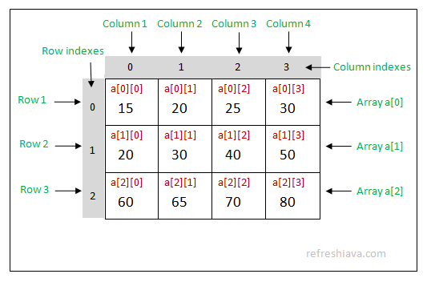
2D arrays
Since 2D array is an array of 1D arrays, so you can think of the arrays given in {{15,20,25,30},{20,30,40,50},{60,65,70,80}}; like below
{a[0],a[1],a[2]};
Here a[0], a[1], a[2] are arrays itself which points the corresponding arrays.
To access values in 2D arrays you need to use it's row and column indexes like a[0][0], a[0][1], a[0][2] and so on. In above example a[0][0] will return 15, a[0][1] will return 20 and a[0][2] will return 25.

Slide 7
2D array example
class TwoDArray
{
public static void main(String [] args)
{
int[][] matrix = new int[2][2];
matrix[0][0] = 10;
matrix[0][1] = 20;
matrix[1][0] = 30;
matrix[1][1] = 40;
System.out.println("Element at index 00 = "+matrix[0][0]);
System.out.println("Element at index 01 = "+matrix[0][1]);
System.out.println("Element at index 10 = "+matrix[1][0]);
System.out.println("Element at index 11 = "+matrix[1][1]);
int[][] a = {{15,20,25},{20,30,40},{50,60,70}};
System.out.println("\nElement at index 00 = "+a[0][0]);
System.out.println("Element at index 01 = "+a[0][1]);
// Accessing array elements using for loop;
System.out.println("\nAccessing array element using for loop ........");
for(int i=0; i < a.length; i++)
{
for(int j=0; j < a[i].length; j++)
System.out.println("Element at index "+i+""+j+" = "+a[i][j]);
}
}
}

Slide 8
String
A String in Java is a sequence of characters, represented by the String class.
Strings are immutable, meaning their values cannot be changed after creation.
String Declaration and Initialization
Example: String message = "Hello, World!";
Immutable Nature of Strings
Once a string is created, its value cannot be changed.
Any operation that seems to modify a string creates a new string in memory.

Slide 9
Useful Methods of String Class
Length(), isEmpty(), and charAt()
length() returns the number of characters in the string.
isEmpty() checks if the string is empty.
charAt(index) returns the character at the specified index.
Substring() and indexOf()
substring(startIndex) returns a new string starting from the specified index.
indexOf(substring) finds the first occurrence of the specified substring.
equals() and equalsIgnoreCase()
equals(anotherString) compares two strings for equality.
equalsIgnoreCase(anotherString) compares two strings for equality, ignoring case.
toUpperCase() and toLowerCase()
toUpperCase() converts the entire string to uppercase.
toLowerCase() converts the entire string to lowercase.
trim() and replace()
trim() removes leading and trailing whitespaces.
replace(oldChar, newChar) replaces all occurrences of oldChar with newChar.

Slide 10
StringBuffer and StringBuilder
String vs. StringBuffer vs. StringBuilder
Strings are immutable, while StringBuffer and StringBuilder are mutable.
StringBuffer and StringBuilder are used for efficient string manipulation.
StringBuffer Class: Declaration and Initialization
StringBuffer can be declared and initialized using new StringBuffer().
Example: StringBuffer buffer = new StringBuffer();
StringBuffer Methods: append(), insert(), delete(), and more
append(str) adds the specified string to the end of the buffer.
insert(index, str) inserts the specified string at the given index.
delete(start, end) removes characters from the buffer.
StringBuilder Class: Declaration and Initialization
StringBuilder can be declared and initialized using new StringBuilder().
Example: StringBuilder builder = new StringBuilder();
StringBuilder Methods: append(), insert(), delete(), and more
append(str) and other methods in StringBuilder are similar to those in StringBuffer.
If thread-safety is needed, use StringBuffer; otherwise, prefer StringBuilder for better performance in single-threaded environments.

Slide 11
String example
3. Building a CSV String using StringBuilder
String[] data = {"Rama", "Krishna", "30", "Engineer"};
StringBuilder csvBuilder = new StringBuilder();
for (int i = 0; i < data.length; i++) {
csvBuilder.append(data[i]);
if (i < data.length - 1) {
csvBuilder.append(",");
}
}
System.out.println("CSV: " + csvBuilder);
// Output: CSV: Rama,Krishna,30,Engineer
Reversing a String
String text = "hello";
StringBuilder reversedText = new StringBuilder();
for (int i = text.length() - 1; i >= 0; i--) {
reversedText.append(text.charAt(i));
}
System.out.println("Reversed: " + reversedText);
// Output: Reversed: olleh
2. Counting Occurrences of a Substring in a String
String text = "abababab";
String substring = "ab";
int count = 0;
int index = text.indexOf(substring);
while (index != -1) {
count++;
index = text.indexOf(substring, index + 1);
}
System.out.println("Count: " + count);
// Output: Count: 4
4. Check if string is Palindrome
String text = "radar";
boolean isPalindromic = true;
for (int i = 0; i < text.length() / 2; i++) {
if (text.charAt(i) != text.charAt(text.length() - 1 - i)) {
isPalindromic = false;
break;
}
}
System.out.println("Is Palindromic: " + isPalindromic);
// Output: Is Palindromic: true

Slide 12
Binary Search
Binary Search is an efficient algorithm used to find the index of a target element in a sorted array.
Requirements:
The array must be sorted in ascending (or descending) order for binary search to work correctly.
It works only with random-access data structures like arrays (or contiguous memory).
Algorithm:
Compare the target element with the middle element of the array.
If the target is equal to the middle element, return the index.
If the target is greater, search the right half of the array.
If the target is smaller, search the left half of the array.
Repeat the process until the element is found or the search space is empty.
Time Complexity:
Binary Search has a time complexity of O(log n), which makes it efficient for large sorted arrays.
Implementation:
The iterative approach uses a while loop to perform the search.
The recursive approach divides the array into halves and calls itself on the appropriate subarray.
Use Cases:
Binary Search is used in various applications, including searching in databases, finding positions in sorted lists, and more.

Slide 13
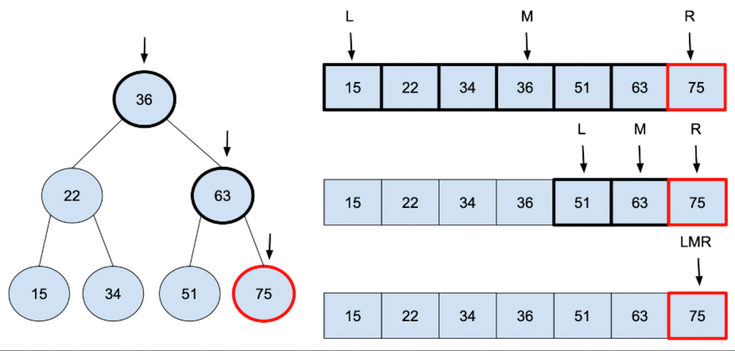
Binary Search
public class BinarySearchExample {
public static int binarySearch(int[] arr, int target) {
int left = 0;
int right = arr.length - 1;
while (left <= right) {
int mid = left + (right - left) / 2;
if (arr[mid] == target) {
return mid;
} else if (arr[mid] < target) {
left = mid + 1;
} else {
right = mid - 1;
}
}
return -1;
}
public static void main(String[] args) {
int[] arr = {1, 3, 5, 7, 9, 11, 13, 15, 17, 19};
int target = 11;
int result = binarySearch(arr, target);
if (result != -1) {
System.out.println("Element found at index: " + result);
} else {
System.out.println("Element not found in the array.");
}
}
}

Slide 14
Key points
Arrays are data structures that store a fixed-size, contiguous collection of elements of the same type.
Declaration and Initialization:
Arrays are declared using square brackets ([]) after the data type, like int[] numbers;.
They can be initialized with values using curly braces {} and commas, like int[] numbers = {1, 2, 3};.
Accessing Elements:
Array elements are accessed using their index, starting from 0.
Example: int firstElement = numbers[0];.
Array Length and Bounds:
The length of an array can be obtained using the length property: int size = numbers.length;.
Array bounds represent the valid range of index values for the array.
Common Operations:
Arrays are commonly used for iterating, searching, and modifying elements.
Strings are sequences of characters, represented by the String class in Java.
Strings can be declared and initialized using double quotes, like String message = "Hello";.
Strings are immutable, meaning their values cannot be changed once created.
Any operation that seems to modify a string creates a new string in memory.
Strings have numerous useful methods for tasks such as concatenation, substring, case conversion, and more.

